Slide 1
CUSTOMER SHOPPING BEHAVIOR ANALYSIS
3,900 purchases
show where to invest next
Transactional data across four product categories
Uncover spending patterns, segments, product preferences and subscription behavior to guide strategic decisions.

Slide 2
from raw data to
decision-ready insight
01
02
03
04
Clean in Python
Engineer fields
Query MySQL
Publish Power BI
3,900 rows, 18 columns. Filled 37 missing review ratings with category medians.
Age groups and purchase frequency. Dropped the redundant promo code field.
Answered ten business questions.
An interactive dashboard.

Slide 3
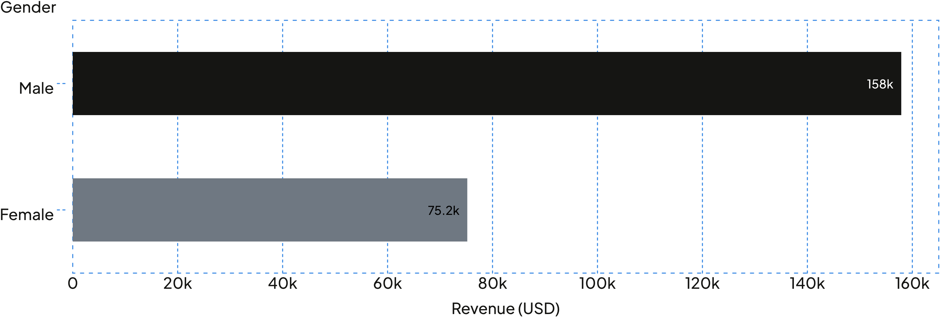
male customers drive twice the
revenue of female customers
Male $157,890 · Female $75,191

Slide 4
subscribers spend the same as
everyone else, and there are few of them
SUBSCRIBERS
NON-SUBSCRIBERS
1,053
2,847
subscribers
non-subscribers
$59.49 average spend
$59.87 average spend
$62,645 total revenue
$170,436 total revenue

Slide 5
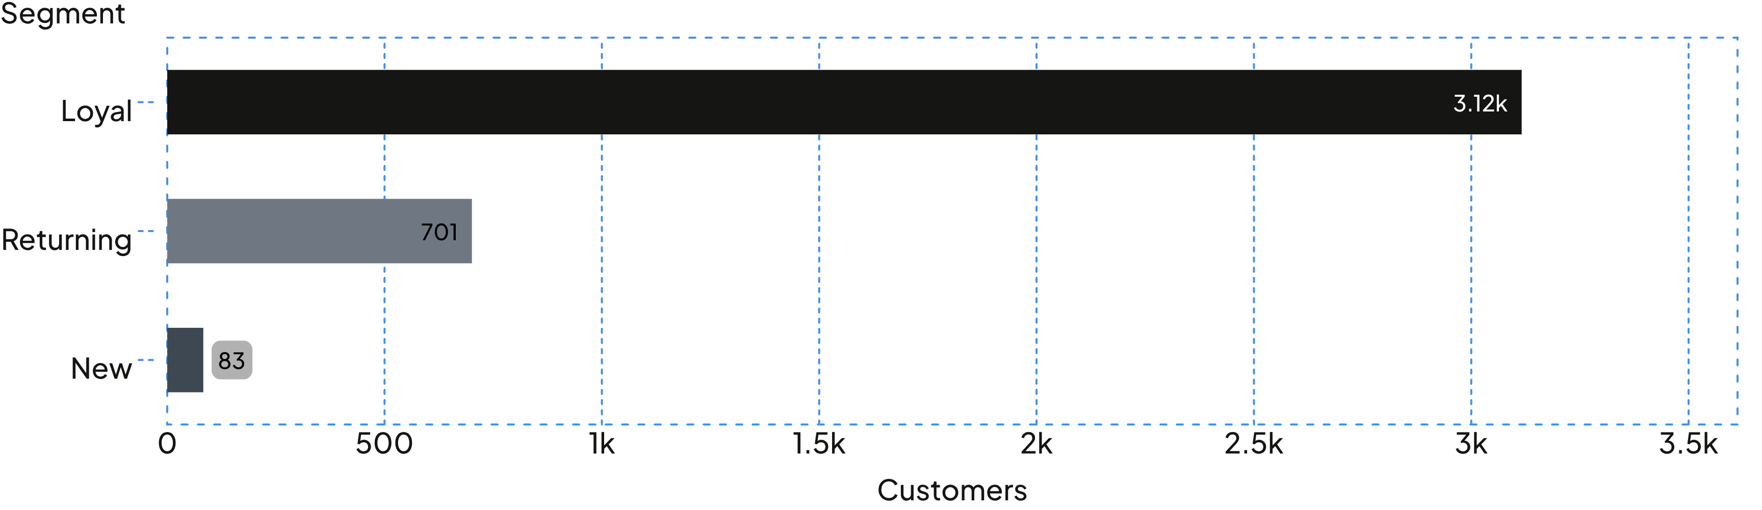
most customers are already loyal
Repeat buyers (5+ purchases) include 958 subscribers and 2,518 non-subscribers: loyalty has not converted into subscriptions.

Slide 6
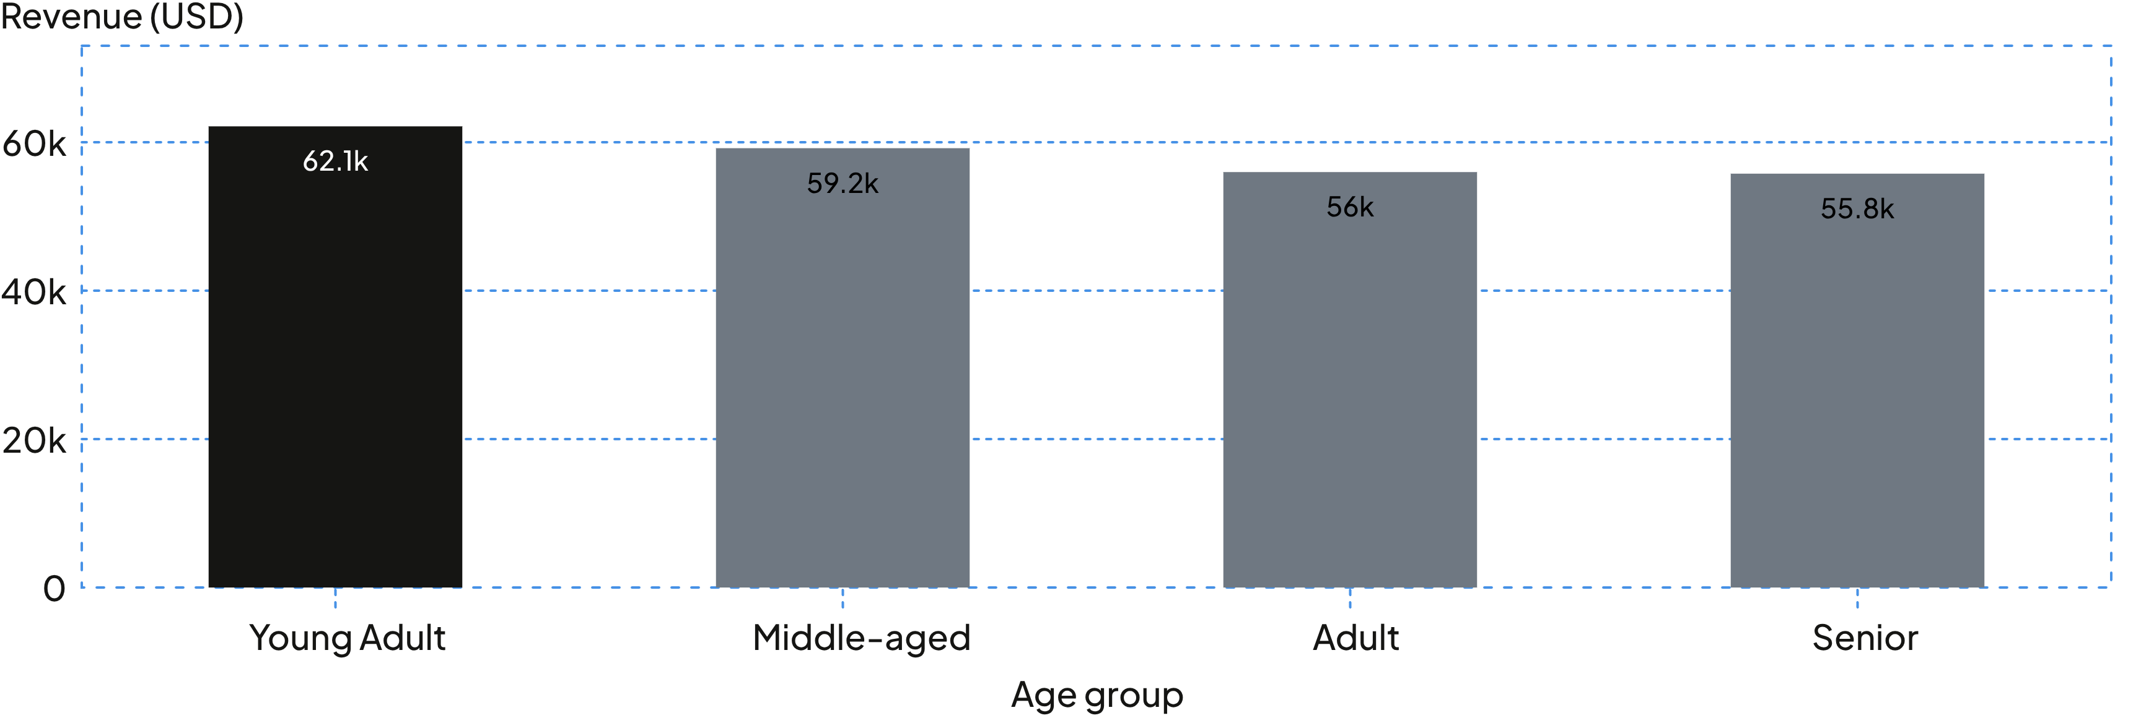
young adults lead revenue,
but age groups sit close together

Slide 7
top-rated items are not
the discounted ones
Highest rated
Most discount-dependent
Item | Rating
Gloves | 3.86
Sandals | 3.84
Boots | 3.82
Hat | 3.80
Skirt | 3.78
Item | Discount %
Hat | 50.00%
Sneakers | 49.66%
Coat | 49.07%
Sweater | 48.17%
Pants | 47.37%
Best sellers: Jewelry, Blouse, Pants, Sandals and Jacket lead their categories.

Slide 8
discounts and express shipping
both coincide with strong spend
AVERAGE SPEND
839
$60.48
customers used a discount and still spent above the average purchase.
Express
$58.46 Standard

Slide 9
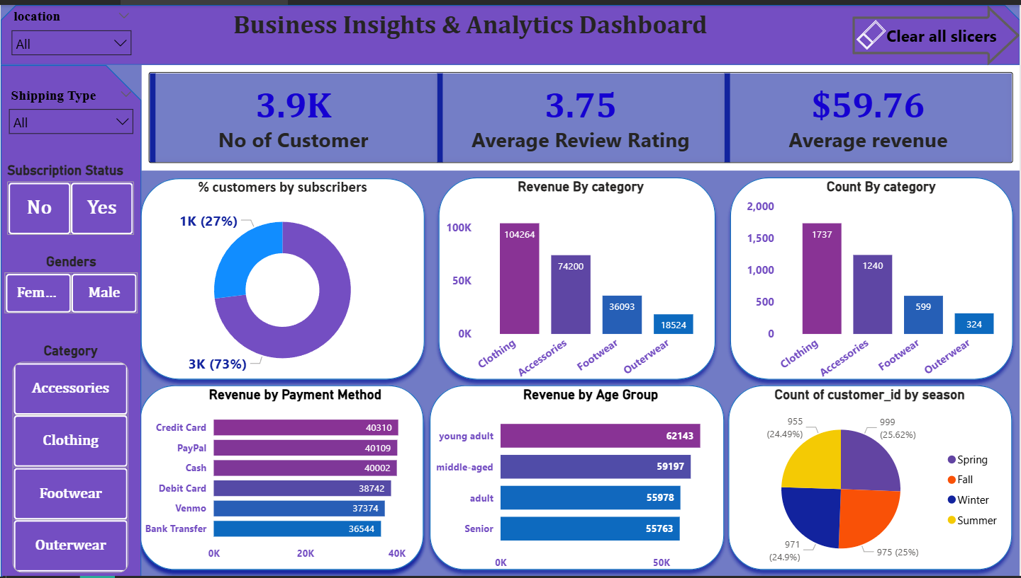
The dashboard puts it all in one view
3,900 customers · 3.75 average review rating · $59.76 average purchase
Clothing is the largest revenue category.

Slide 10
five moves to invest in
Boost subscriptions with exclusive benefits
01
Reward repeat buyers through loyalty programs
02
Review discount policy to balance sales and margin
03
Highlight top-rated and best-selling products in campaigns
04
Target high-revenue age groups and express-shipping users
05

